Slide 1

CREDIT SCORE FORECASTIG

Slide 2
Overview
What is credit score?
Credit score is a numerical rating that measures a person's likelihood to repay a debt.
A higher credit score indicates that a loanee is lower risk and more likely to make on-time payments.
The data set contains a set of features that include an important set of information that has a direct impact on the credit score, and others that have no impact.
- Credit score is classified into three grades:
Good
Standard
poor

Slide 3
Problem Definition
credit score determines whether you will be approved for a loan and what interest rate you will pay. Prospective employers also check it to see whether you're a reliable person. Service providers and utility companies may check it to decide whether you have to make a deposit.
credit rating and risk assessment tools are used to minimize potential risk up to some extent for credit score.
The challenge here is to identify insights on the performance of a finance industry by using machine learning algorithms as they directly affect the viability of that industry.

Slide 4
Our Target
It is to classify clients based on their credit score to decide whether to accept their request of a loan or not.
And our goal will be to increase the accuracy of the credit score and reduce the risk for lenders.

Slide 5
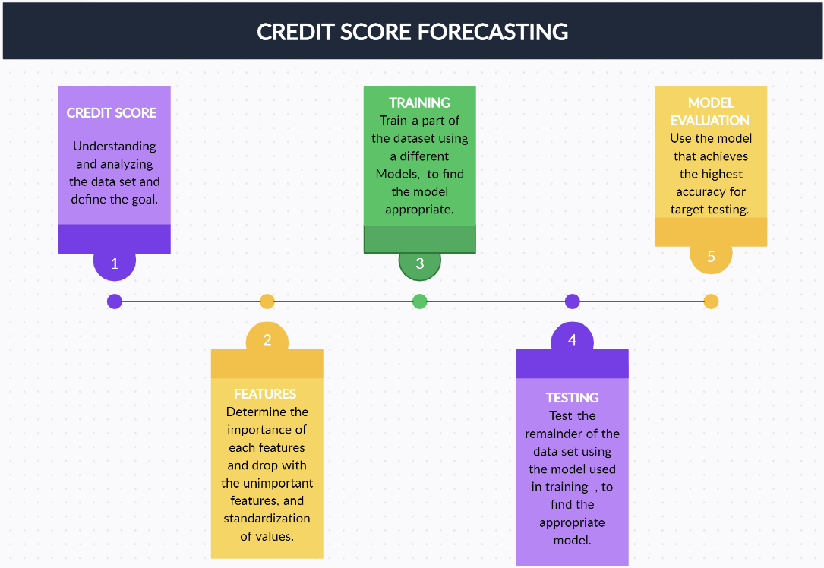
Problem Structuring
At this point, the sequential work steps will be clarified :

Slide 6
Problem Structuring
data collection and discovery :
our data set includes individuals' demographic and financial information, including income, credit history, employment status, age, education level, and other relevant factors. We also have the factors that directly influence credit scores, such as payment history, amounts owed, length of credit history, new credit, and types of credit used.
the shape of our data set is (100,000 Row & 28 Feature )

Slide 7
Problem Structuring(continued)
Feature identification
The top ten features that have the greatest impact on our target (credit score) are :
Outstanding Debt - Represents the remaining debt to be paid (in USD)
Interest Rate - Represents the interest rate on credit card
Credit Mix - Represents the variety of the mix credits
Credit History Age - Represents the age of credit history of the person

Slide 8
Problem Structuring(continued)
Delay from due date - Represents the average number of days delayed from the payment date
Changed Credit Limit - Represents the percentage change in credit card limit
Monthly Balance - Represents the monthly balance amount of the customer (in USD)
Num Credit Inquiries - Represents the number of credit card inquiries
Total EMI per month - Represents the monthly EMI(Equated monthly installment) payments in USD

Slide 9
Problem Structuring
Data cleaning :
we checked of our dataset and it was empty of any missing value.
But we removed some unwanted record that will misleading and affects on the model.

Slide 10
Problem Structuring
feature engineering :
choose the most important feature in dataset and removed unnecessary
Feature like :( ID , ID_Customer , Names , SSN )
And encoding any feature nominal to numeric to let all feature is numeric

Slide 11
Problem Structuring
choosing model :
we choosing random forest classifier to moduling our dataset and give us the most accuracy.
The random forest importance (RFI) method is a filter feature selection method that uses the total decrease in node impurities from splitting on a particular feature as averaged over all decision trees in the ensemble.

Slide 12
Problem Structuring
training and testing :
The main difference between training data and testing data is that training data is the subset of original data that is used to train the machine learning model, whereas testing data is used to check the accuracy of the model.
The training dataset is generally larger in size compared to the testing dataset.
Our dataset is divided into 80% training and 20% testing with an (RFI) model.
The (RFI) model gave an accuracy of 83% when testing the data.

Slide 13
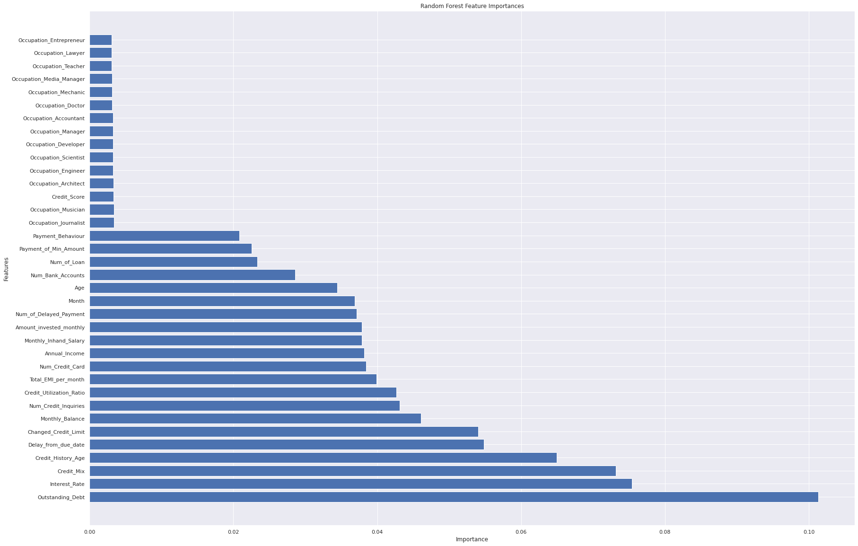
Problem Structuring(continued)

Slide 14
Hypotheses
hypothesis number (1) :
While the number of Loan increase, the degree of the Credit Score decrease.
hypothesis number (2) :
When the History age increase, the degree of the Credit Score decrease.
hypothesis number (3) :
While the payment behavior is Low-Spent, the ratio of the (Good) Credit Score will be the highest.
hypothesis number (4) :
The increasement of the Annual Income results in the ratio of the (Good) Credit Score increased.

Slide 15
Hypotheses (continued)
hypothesis number (5) :
The increasement of Outstanding Debt results in the ratio of the Credit Score decrease.
hypothesis number (6) :
While the value of Amount invested monthly increase, the degree of the Credit Score increased.

Slide 16
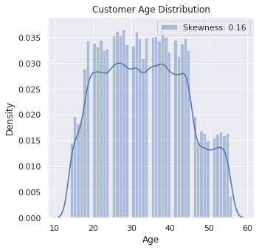
Tasks Identification
In this part of the project we will demonstrate features with data visualizations.
Age :
It is a features that represents the ages of customers in the data set, as the percentage of the most frequent ages was (20-45).

Slide 17
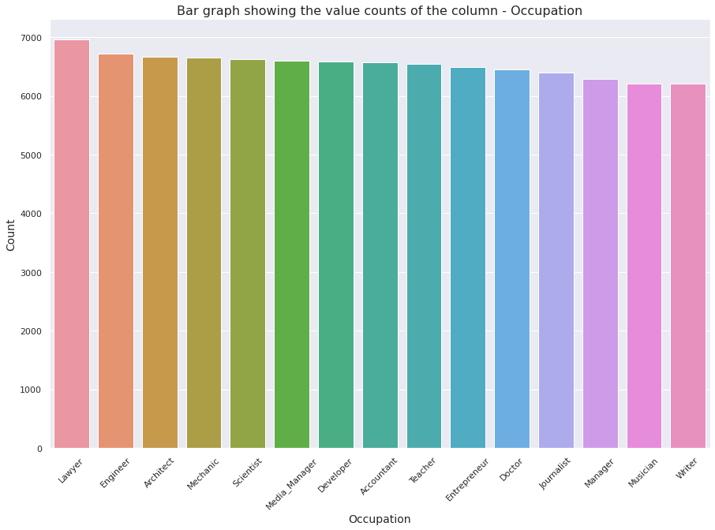
Tasks Identification
Occupation :
Profession: Representing the professions for each client so that the most common professions are (lawyer).

Slide 18
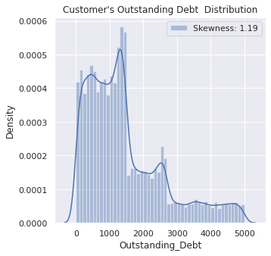
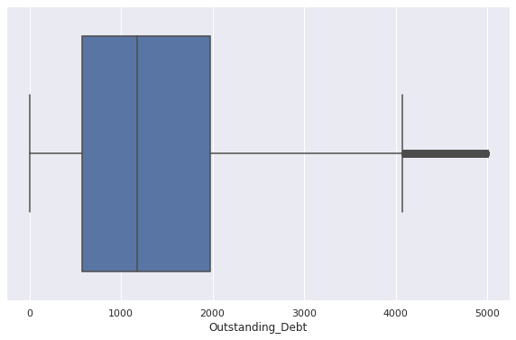
Tasks Identification
Outstanding Debt :
Outstanding debt can be on a credit card and loans, and is represented by a fixed monthly amount that must be paid until it is completed.
where the mean amount in our data set was (1,000) , and the outliers were in between (4000-5000).

Slide 19
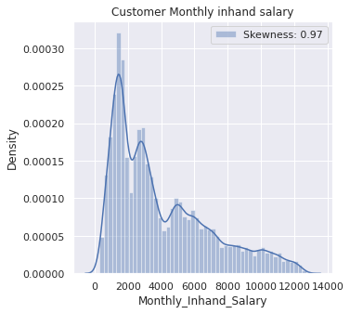
Tasks Identification
Monthly Inhand salary :
It is the monthly salary of the customer.
where the most common monthly salary are amount in our data set was (2,000).

Slide 20
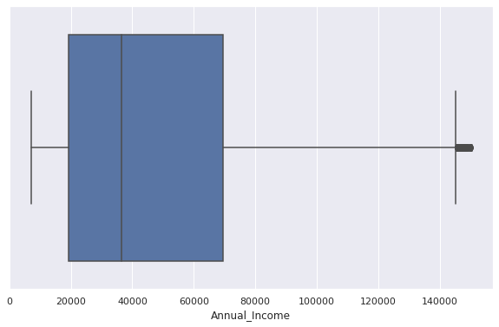
Tasks Identification
Annual income :
It is the total monthly income over the year minus taxes.
where the mean annual income amount in our data set was (3,800) , and the outliers were in above (140,000).

Slide 21
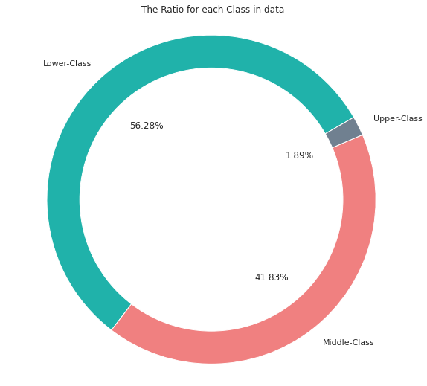
Tasks Identification
The annual income in the data set was classified into several classes , so that the percentages of these categories were distributed as follows :
Lower class (20,000 – 60,000)$ with “56.28%”.
Middle class (60,000 – 140,000)$ with “41.83%”.
Upper class (140,000 – 180,000)$ with “1.89%”.

Slide 22
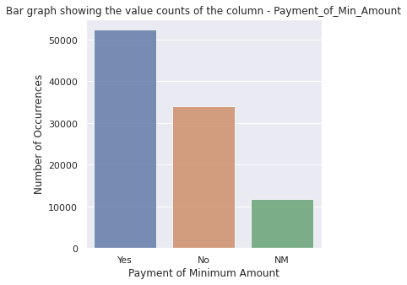
Tasks Identification
Payment of Min Amount :
Represents whether the person paid only the minimum amount.
- The bar graph Showing the value of features Payment of Min Amount .

Slide 23
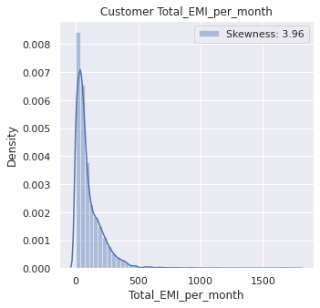
Tasks Identification
Total EMI per month :
Represents the monthly EMI(Equated monthly installment) payments in USD.

Slide 24
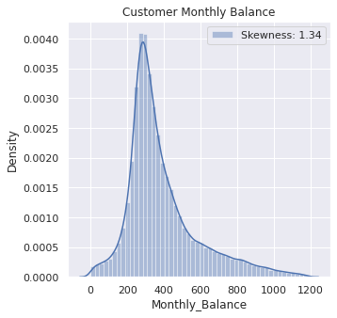
Tasks Identification
Monthly Balance :
is the minimum amount of money that the account holder has to maintain in their current account or savings account.
The most common minimum monthly balance required for customer accounts in our data set was (300).

Slide 25
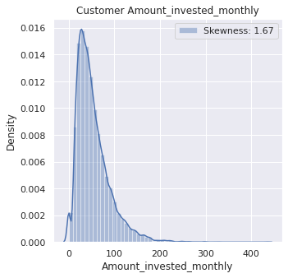
Tasks Identification
Amount invested monthly :
Represents the monthly amount invested by the customer
(in USD(.
where the most common monthly salary are amount in our data set was (50$).

Slide 26
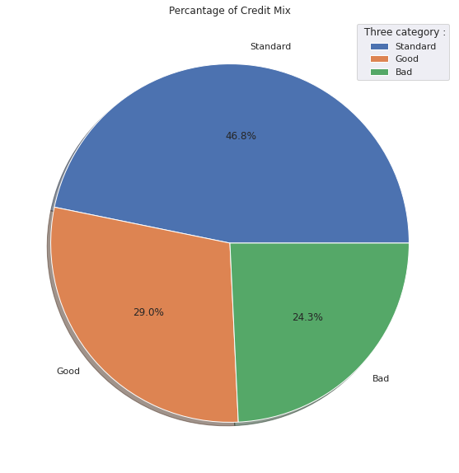
Tasks Identification
Credit Mix :
Represents the variety of the mix credits.
Customers are categorized into three types of use credit mix, the proportion of each was as follows :
Standard (46.8%)
Good (29%)
Bad (24.3%)

Slide 27
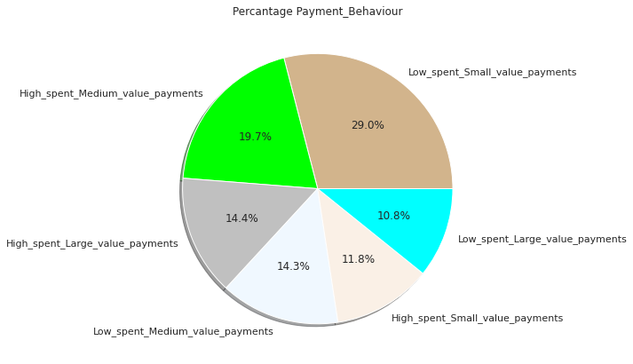
Tasks Identification
Payment behavior :
Represents the payment behavior of the customer
User behavior has been analyzed into several types, the proportion of each was as follows :
Low spent – small value payments (29%)
High spent – medium value payments (19.7%)
High spent – large value payments (14.4%)
Low spent – medium value payments (14.3%)
High spent – small value payments (11.8%)
Low spent – large value payments (10.8%)

Slide 28
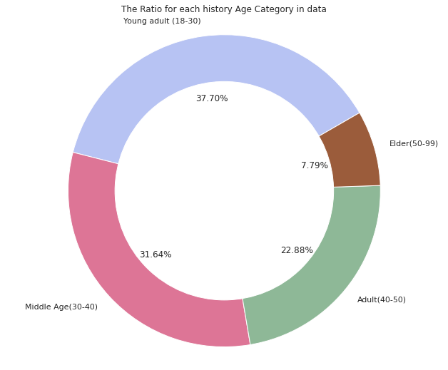
Tasks Identification
The ages in the data set were classified into several age groups, so that the percentages of these groups were distributed as follows :
Young adult (18-30) with “37.7%”.
Middle age (30-40) with “31.64%”.
Adult (40-50) with “22.88”.
Elder (50-99) with “7.79”.

Slide 29
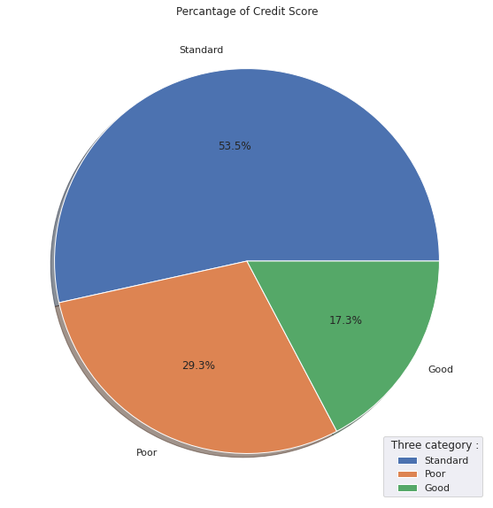
Tasks Identification
Credit score is categorized into three grades, and credit score percentages refer to the proportion of each in the data set, as follows :
Standard (53.5%).
Poor (29.3).
Good (17.3).
We also notice that the good is the lowest percentage among them.

Slide 30
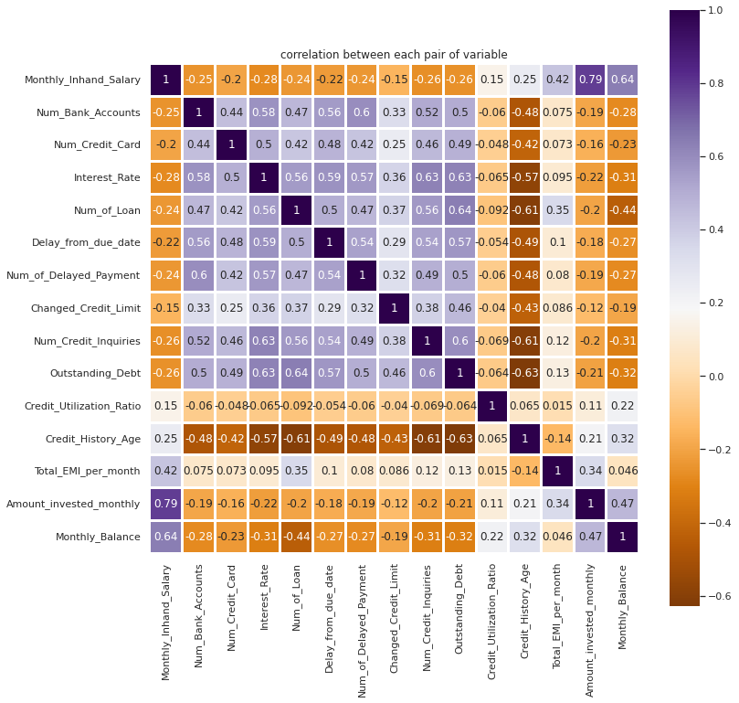
Tasks Identification

Slide 31
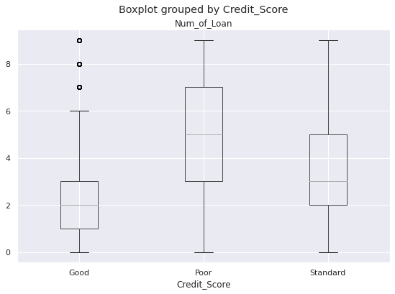
Hypotheses Result
hypothesis number (1) :
While the number of Loan increase, the degree of the Credit Score decrease.
The result : is Accept as we watch the median of number of loan in Good classify equal 2 while in Poor equal 5.

Slide 32
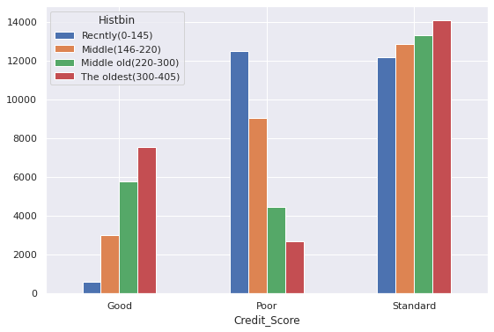
Hypotheses Result
hypothesis number (2) :
When the History age increase, the degree of the Credit Score decrease.
The result : is Accept as we watch recently customer is too high in Poor classify but in Good classify the oldest customer earn high classify

Slide 33
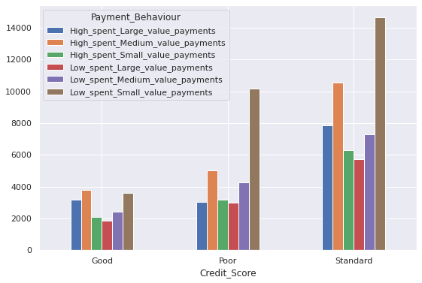
Hypotheses Result
hypothesis number (3) :
While the payment behavior is Low-Spent, the ratio of the (Good) Credit Score will be the highest.
The result : is Accept as we watch whenever the spent is low the percentage of Good classify is increase

Slide 34
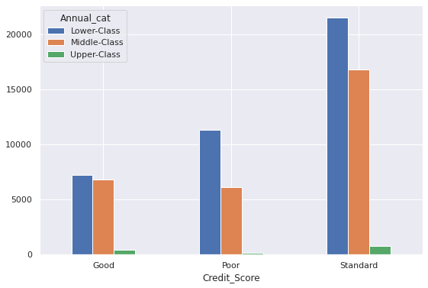
Hypotheses Result
hypothesis number (4) :
The increasement of the Annual Income results in the ratio of the (Good) Credit Score increased.
That’s classes divided depending on annual salary
The result : is Accept as we watch whenever the lower class increase the credit score decrease and vice versa and whenever upper class increase the credit score increase

Slide 35
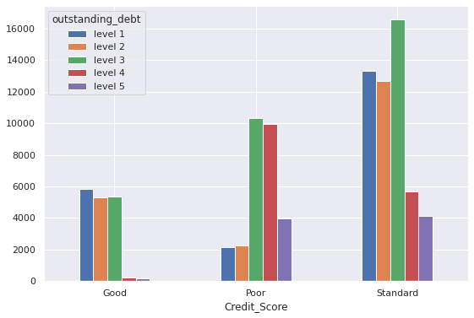
Hypotheses Result
hypothesis number (5) :
The increasement of Outstanding Debt results in the ratio of the Credit Score decrease.
The levels represent the amount of outstanding dept and while the level grows the value of dept grown
The result : is Accept as we watch the Good classify have a few value of outstanding and if the value increased the value of credit score will decreased

Slide 36
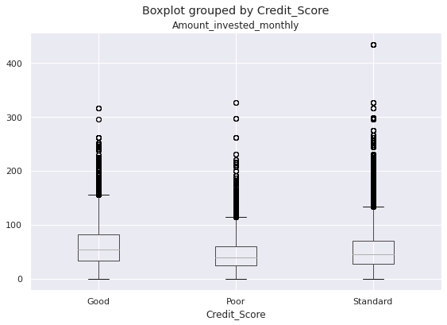
Hypotheses Result
hypothesis number (6) :
While the value of Amount invested monthly increase, the degree of the Credit Score increased.
The result : is Accept as we watch the Good classify have a higher amount invested and vice versa for Poor classification

Slide 37
Statistical Analysis
Statistical analysis is the collection and interpretation of data in order to uncover patterns and trends. It is a part of data analytics.
Some concepts that explain the data better :
Mean : the "average" , where you add up all the numbers and then divide by the number of numbers.
Median : the middle number in a sorted, ascending or descending list of numbers and can be more descriptive of that data set than the average.
variance : the term variance refers to a statistical measurement of the spread between numbers in a data set.
standard deviation : is a measure of the amount of variation or dispersion of a set of values.
Max : the maximum value of a set of values.
Min : the minimum value of a set of values.

Slide 38
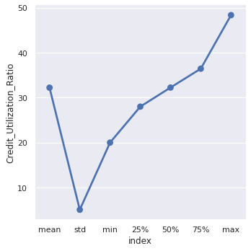
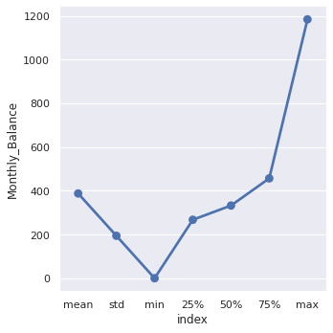
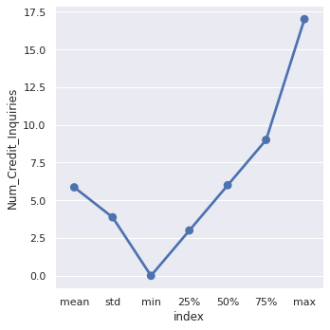
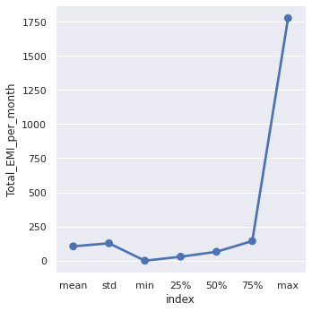
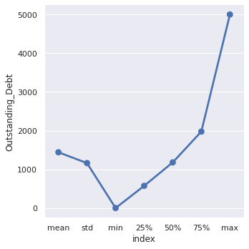
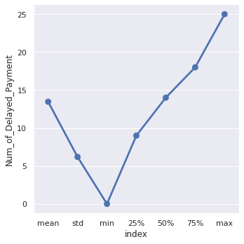
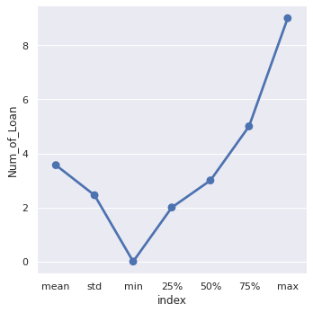
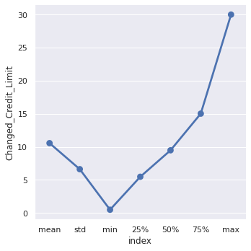
Statistical Analysis

Slide 39
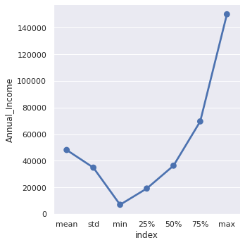
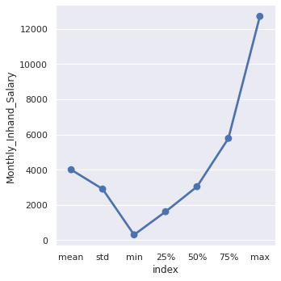
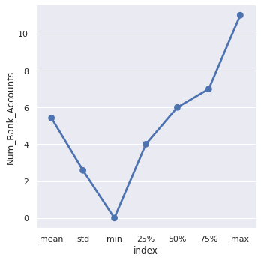
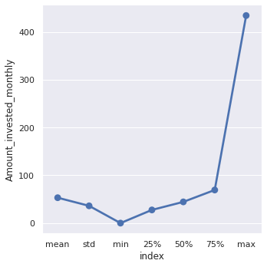
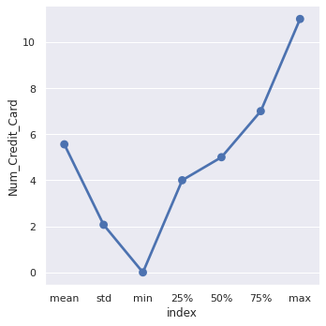
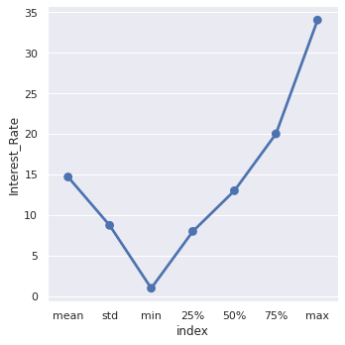
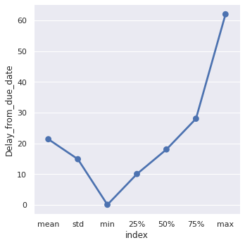
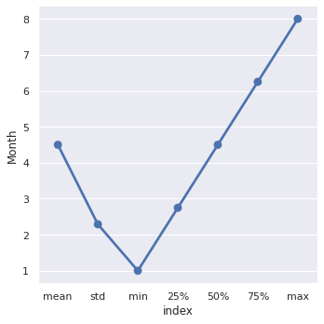
Statistical Analysis

Slide 40
The End
Thanks for your attention
Implement by :
- Mohammad abu al-inani
- Baker al-mohtaseb
- Hala bgoor

